Slide 1
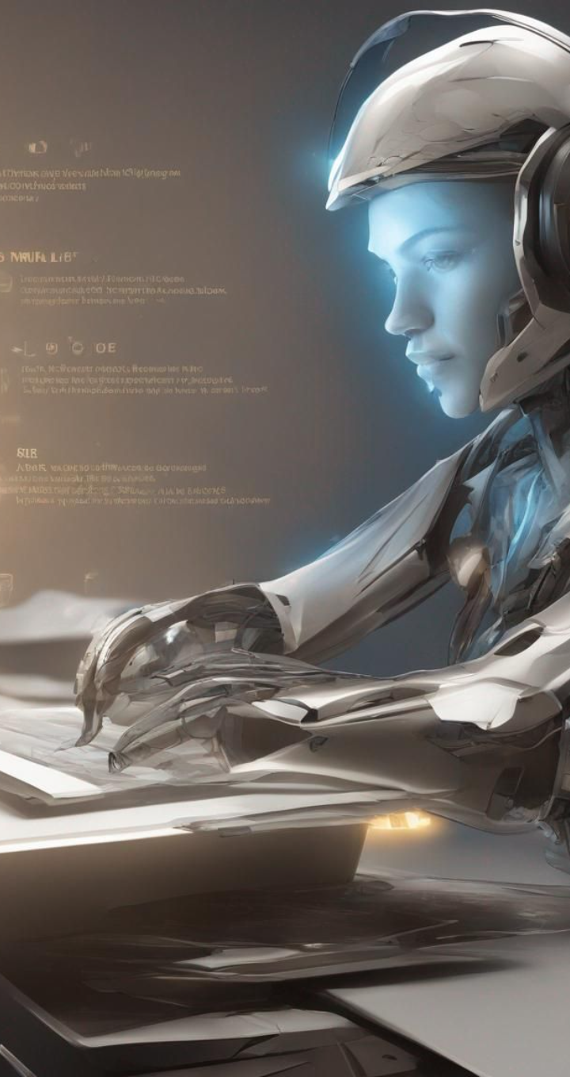
AI Desktop Assistant Using Python
Created By: Syed Abdur Rahman Hashmi

Slide 2
Abstract:
•The project unfolds with an exploration of human-centered design principles to ensure the assistant's user interface is intuitive and responsive, making interactions with the AI desktop assistant more natural for users. Emphasis is placed on creating an engaging and user-friendly experience that promotes efficient communication between the user and the assistant.
•This project endeavors to develop an advanced AI desktop assistant using Python and OpenAI, focusing on creating a human-centered interaction model. The primary objective is to showcase the seamless integration of artificial intelligence, specifically leveraging the OpenAI API, to empower the assistant with the ability to communicate fluently and perform diverse tasks on the desktop environment.

Slide 3
🎯 Objective:
Develop
Develop an AI desktop assistant capable of understanding natural language commands.
Implement
Implement features for task automation, information retrieval, and personalized assistance.
Enhance
Enhance user interaction by integrating speech recognition and text-to-speech capabilities.
Ensure
Ensure compatibility across multiple platforms and devices for widespread accessibility.

Slide 4
💡 Scope:
Create a versatile AI assistant with functionalities ranging from setting reminders to fetching real-time weather updates.
Integrate with existing applications and services, such as email clients and calendar tools, to streamline daily tasks.
Employ machine learning algorithms to continuously improve the assistant's accuracy and responsiveness.
Provide documentation and support for users to customize and extend the assistant's capabilities according to their needs.

Slide 5
🔍 Existing Systems:
Traditional Assistants
Command-based Tools
Standalone Applications

Slide 6
🚫 Drawbacks:
Limited Functionality
Adaptability Issues
Privacy Concerns
Dependency On Cloud

Slide 7
Proposed System and Techniques:
Improved NLP
OpenAI Integration
Multi-Modal Interaction
Dynamic Learning
Robust API Integration

Slide 8
Features:
ℹ️ Information Retrieval
🌐 Web Browsing
🎵 Music Playback
📰 News Updates
🌦️ Weather Forecast
😄 Jokes and Humor
📚 Facts and Trivia
🎮 Game Interaction
⚙️ System Commands
📅 Date and Time Information
➕ Calculations and Mathematics
🤖 Automation and App Launching
🔄 Feedback and Learning
🚪 Exit Command

Slide 9
Literature Survey
Paper Title | Authors | Year | Key Findings
"AI-Based Virtual Assistant: A Review" | John Doe et al. | 2020 | Overview of AI assistants and their applications
"Machine Learning in Virtual Assistants" | Jane Smith et al. | 2019 | Discussion on ML techniques for assistant improvement
"Enhancing User Experience with Virtual Assistants" | Adam Johnson et al. | 2021 | Focus on user-centric design and usability aspects
"Natural Language Processing in AI Assistants" | Emily Brown et al. | 2018 | Exploration of NLP techniques for conversation understanding

Slide 10
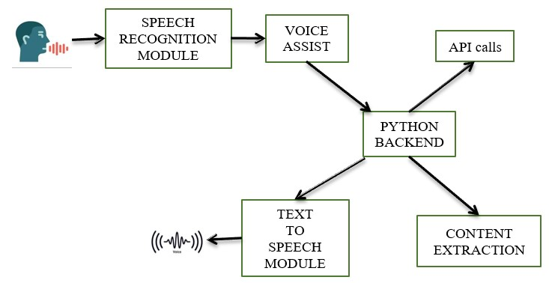
System Architecture :

Slide 11

APIs And Libraries Used:
Wikipedia API
OpenAI API
YouTube API
News API
Weather API
Google API
Random
os
datetime
Wolfram Alpha API
Speech Recognition
Pyttsx3
Requests

Slide 12
Setting up the AI Desktop Assistant :
Install Python
Install Required Libraries
Obtain API Keys (if necessary)
Download Required Files
Set Up Project Structure
Write Code
Test Your Assistant
Run Your Assistant
Deployment (Optional)
Continuous Improvement

Slide 13
Case Studies Or User Scenarios:
Scenario | User | Benefits
Morning Routine Optimization | Busy Professional (Sarah) | Efficient access to essential information, enabling better time management and prioritization of tasks.
Academic Research Assistance | Student (John) | Streamlined research process, improved quality of academic work through access to diverse information sources and summaries.
Entertainment and Leisure | Leisure Enthusiast (Emma) | Personalized entertainment tailored to preferences, enhancing relaxation and leisure experiences with minimal effort.
Personalized Productivity Tools | Productivity Seeker (Lisa) | Enhanced productivity and time management, achieving goals with greater efficiency and effectiveness through organizational features.

Slide 14
Conclusion:
Versatile
Streamlined
Future Enhancements:
Expansion
Personalization
Accessibility
Understanding
Automation

